Slide 1
Lecture 8 Instruction Sets: Characteristics and Functions
Objective:
Understand the factors involved in instruction set architecture design.
Instruction format
Instruction type
Architecture of data in CPU

Slide 2
Introduction
This chapter builds upon the ideas up to Chapter 4.
We present a detailed look at different instruction formats, operand types, and memory access methods.
We will see the interrelation between machine organization and instruction formats.
This leads to a deeper understanding of computer architecture in general.

Slide 3
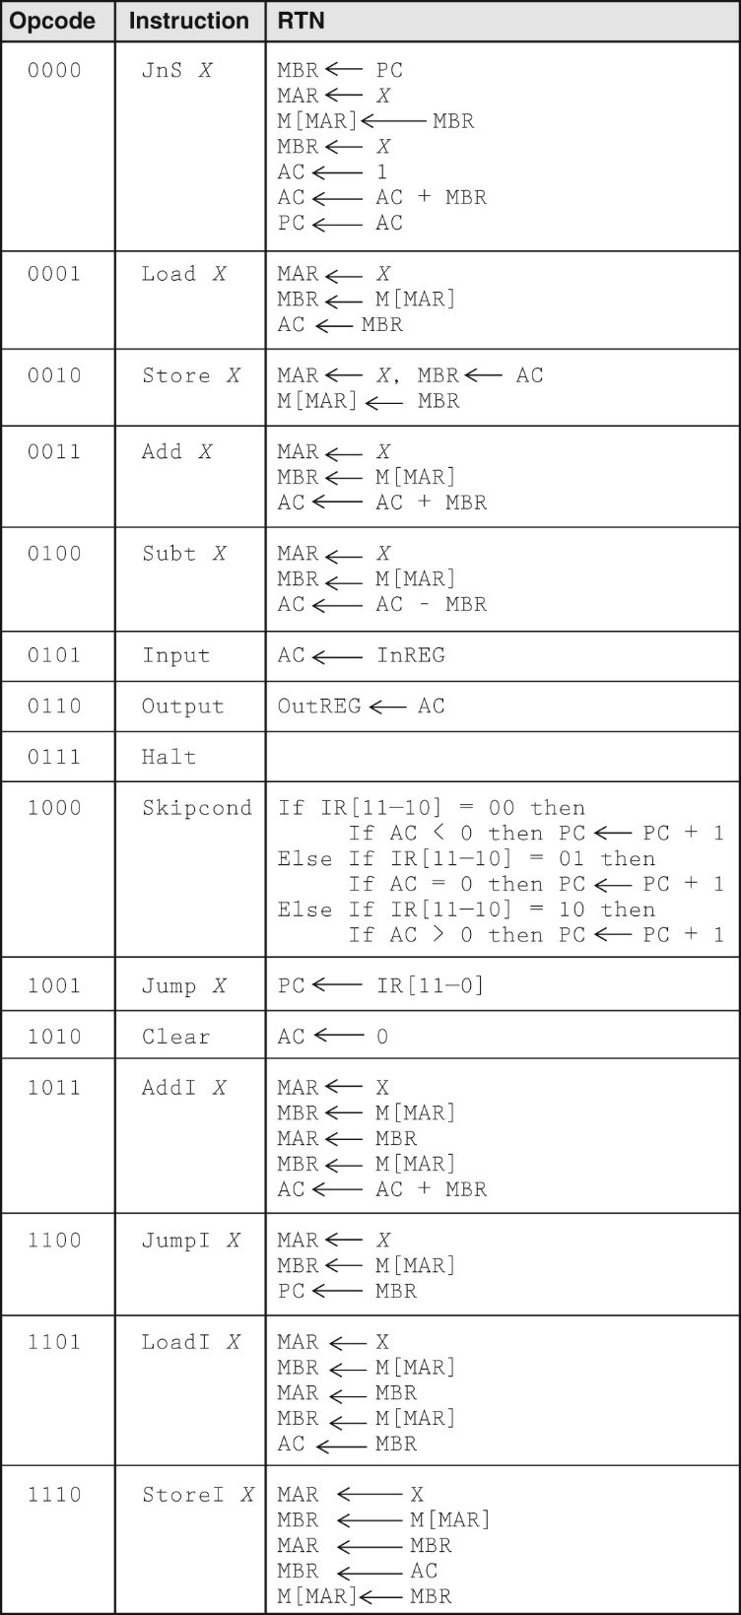
What is an instruction set?
Instruction set architecture of MARIE
The complete collection of instructions that are understood by a CPU
Machine instruction or code (In Binary)
Usually represented by assembly codes
(or mnemonics)
Notes:
2

Slide 4
Instruction Formats
In designing an instruction set, consideration is given to:
Instruction length.
Whether short, long, or variable.
Number of operands.
Number of addressable registers.
Memory organization.
Whether byte- or word addressable.
Addressing modes.
Choose any or all: direct, indirect or indexed.

Slide 5
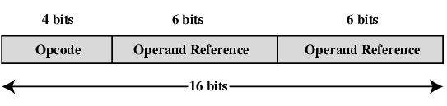
Sample Instruction Format

Slide 6
Instruction Representation
In machine code each instruction has a unique bit pattern
Divided into fields
For human, a symbolic representation is used (Called mnemonics)
e.g. ADD, SUB, LOAD,STORE
Operands can also be represented symbolically
ADD A,B
Note that operation is performed on the contents, not on its address!
Machine language is rare use, but useful for describing machine instructions
Notes:
5

Slide 7
Types of Operand (data referencing)
Machine operations operate on data with the general categories:
Addresses
Numbers
Integer (fixed point)/packed decimal
Limited floating point representation (magnitude vs precision)
Characters
ASCII, EBCDIC etc.
Logical Data
Bits or flags
Notes:
14

Slide 8
Instruction types
Data transfer or movement (to and from register, memory, I/O)
Data processing (arithmetic and logic instructions)
Arithmetic: computational capabilities for processing numeric data
Logic (Boolean): operate on the bits of a word
Perform on data in CPU registers
Data storage (main memory)
Program flow control (Test and branch)
Notes:
6

Slide 9
1.Data Transfer
Specify
Source
Destination
Amount of data
Mode of addressing
May be different instructions for different movements: L, LH, LR in IBM 370
(L for Load from memory to register, LH for load halfword, LR for load from register to register)
Or one instruction (MOV) and different addresses
e.g. VAX → mov op1, op2
VAX’s approach is simpler but less compact
Notes:
19
L = Load (transfer from memory to register)
LH = Load Halfword
LR = Load (transfer from register to register)

Slide 10
2. Data processing: Arithmetic
Add, Subtract, Multiply, Divide
Signed Integer
Floating point
Packed decimal
Maybe single-operand
Increment (a++) → add 1 to operand
Decrement (a--)
Negate (-a)
Notes:
20

Slide 11
2. Data processing: Logical
Bitwise operations
Boolean operation → AND, OR, NOT
Binary test → EQUAL
(R1)=10100101
(R2)=00001111
(R1) AND (R2)=00000101
Logical shift and rotate
Notes:
21

Slide 12
3. Data storage: Byte Order Issues
When keeping data in the storage, Byte ordering, or endianness, is another architectural consideration.
What order do we read numbers that occupy more than one byte (multibyte value)
e.g. (numbers in hex to make it easy to read)
123456AB can be stored in 4 x 8bit locations as follows
Notes:
27

Slide 13
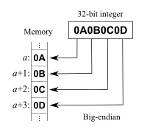
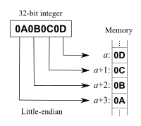
To keep 123456AB at address 184, the byte order can be:
Address Big-endian Little-endian
184 12 AB
185 34 56
186 56 34
187 AB 12
i.e. read top down (big-endian) or bottom up (little-endian)?
Notes:
28

Slide 14
Byte Order: Big- vs Little-Endian
The system with the least significant byte in the lowest address is called little-endian
Most processors follow this, e.g. Intels, ARM, AMD
More and more of systems are little-endian
The system with the most significant byte at the lowest address is called big-endian
Networking, e.g. TCP/IP follows this.
This is a concern if you have to work on the lower network layer!
The system can handle both, called bi-endian
ARM v.3.0 upwards
Notes:
29

Slide 15
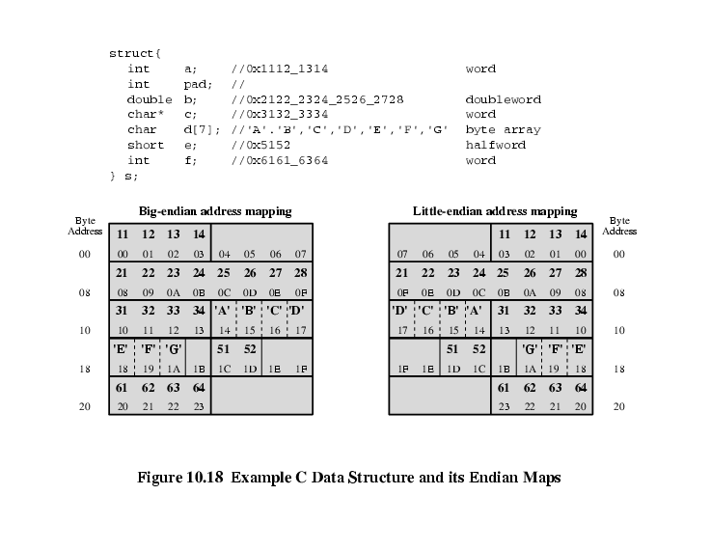
Example of C Data Structure (a 32-bit word)
Notes:
Sample case of 64-bit rows (32-bit word)

Slide 16
Good and bad points for Big and Little Endian
Big endian:
Is more natural.
The sign of the number can be determined by looking at the byte at address offset 0.
Strings and integers are stored in the same order
Little endian:
Makes it easier to place and deal with values on non-word boundaries, e.g. multiple-precision math.
Conversion from a 16-bit integer address to a 32-bit integer address does not require any arithmetic.
Easy to check odd or even number
Ref: http://people.cs.umass.edu/~verts/cs32/endian.html
Notes:
No need to compute exact space for non-word boundaries

Slide 17
Common file formats and their endian order are as follows:
Adobe Photoshop -- Big Endian
BMP (Windows and OS/2 Bitmaps) -- Little Endian
DXF (AutoCad) -- Variable
GIF -- Little Endian
IMG (GEM Raster) -- Big Endian
JPEG -- Big Endian
FLI (Autodesk Animator) -- Little Endian
MacPaint -- Big Endian
PCX (PC Paintbrush) -- Little Endian
PostScript -- Not Applicable (text!)
POV (Persistence of Vision ray-tracer) -- Not Applicable (text!)
QTM (Quicktime Movies) -- Little Endian (on a Mac!)
Microsoft RIFF (.WAV & .AVI) -- Both
Microsoft RTF (Rich Text Format) -- Little Endian
SGI (Silicon Graphics) -- Big Endian
Sun Raster -- Big Endian
TGA (Targa) -- Little Endian
TIFF -- Both, Endian identifier encoded into file
WPG (WordPerfect Graphics Metafile) -- Big Endian (on a PC!)
XWD (X Window Dump) -- Both, Endian identifier encoded into file
http://www.cs.umass.edu/~verts/cs32/endian.html

Slide 18
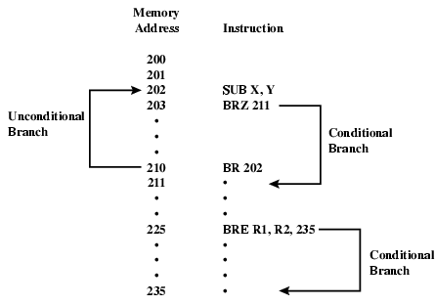
Transfer of Control: Branch Instruction

Slide 19
Transfer of Control
See Figure
on the next page
Branch (or jump instruction)
e.g. branch to x if result is zero [BRZ]
Branch to x if contents of R1 = contents of R2 [BRE]
Skip
e.g. increment and skip if zero
ISZ Register1
Procedure call
A self-contained program incorporated into a larger program
For the economy and modularity
Involve 2 basic instructions: call and return (both are forms of branching)
Notes:
25

Slide 20
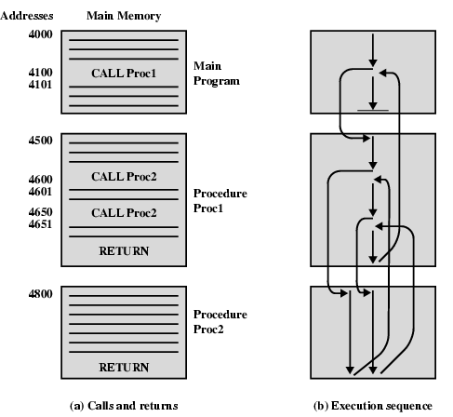
Nested Procedure Calls
Note:
1. Can be called
from > 1 location
2. Can be nested
3. Each call is matched by a return
4. May use stack to control the calls and return

Slide 21
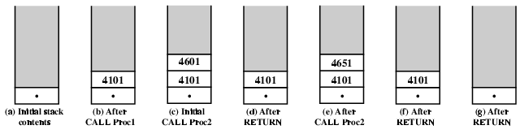
Use of Stack
(1) To manage (recursive) procedure call
(2) Alternate form of addressing
Basic operation : Push, Pop
Typical implemented to grow from higher addresses to lower

Slide 22
Architecture for Data in CPU
The next consideration for architecture design concerns how the CPU will store data.
1. A stack architecture
2. An accumulator architecture (as seen in simple CPU like MARIE)
3. A general purpose register architecture.
In choosing one over the other, the tradeoffs are simplicity (and cost) of hardware design with execution speed and ease of use.

Slide 23
Instruction Formats: GPR
Most systems today are GPR systems.
There are three types:
Memory-memory where two or three operands may be in memory.
Register-memory where at least one operand must be in a register.
Load-store where no operands may be in memory.
The number of operands and the number of available registers has a direct affect on instruction length.

Slide 24
Instruction Formats: Stacking
Stack machines use one - and zero-operand instructions.
LOAD and STORE instructions require a single memory address operand.
Other instructions use operands from the stack implicitly.
PUSH and POP operations involve only the stack’s top element.
Binary instructions (e.g., ADD, MULT) use the top two items on the stack.

Slide 25
Instruction Formats: Number of addresses in ISA
Let's see how to evaluate an infix expression using different instruction formats.
With a three-address ISA, (e.g.,mainframes), the infix expression,
Z = X × Y + W × U
might look like this:
MULT R1,X,Y
MULT R2,W,U
ADD Z,R1,R2
3 addresses
Result, Operand 1, Operand 2

Slide 26
Instruction Formats
In a two-address ISA, (e.g.,Intel, Motorola), the infix expression,
Z = X × Y + W × U
might look like this:
LOAD R1,X
MULT R1,Y
LOAD R2,W
MULT R2,U
ADD R1,R2
STORE Z,R1
Note: Two-address ISAs usually require one operand to be a register.

Slide 27
Instruction Formats
In a one-address ISA, like MARIE, the infix expression,
Z = X × Y + W × U
looks like this:
LOAD X
MULT Y
STORE TEMP
LOAD W
MULT U
ADD TEMP
STORE Z
This can be implemented based on Accumulator architecture.

Slide 28
Instruction Formats
In a stack ISA (zero-addressing), the postfix expression,
Z = X Y × W U × +
might look like this:
PUSH X
PUSH Y
MULT
PUSH W
PUSH U
MULT
ADD
POP Z

Slide 29
Instruction Formats
Stack architectures require us to think about arithmetic expressions a little differently.
We are accustomed to writing expressions using infix notation, such as: Z = X + Y.
Stack arithmetic requires that we use postfix notation: Z = XY+.
This is also called reverse Polish notation, (somewhat) in honor of its Polish inventor, Jan Lukasiewicz (1878 - 1956).

Slide 30
Instruction Formats
The principal advantage of postfix notation is that parentheses are not used.
For example, the infix expression,
Z = (X × Y) + (W × U),
becomes:
Z = X Y × W U × +
in postfix notation.

Slide 31
Instruction Formats
Example: Convert the infix expression (2+3) - 6/3 to postfix:
The sum 2 + 3 in parentheses takes precedence; we replace the term with
2 3 +.
2 3+ - 6/3

Slide 32
Instruction Formats
Example: Convert the infix expression (2+3) - 6/3 to postfix:
The division operator takes next precedence; we replace 6/3 with
6 3 /.
2 3+ - 6 3/

Slide 33
Instruction Formats
Example: Convert the infix expression (2+3) - 6/3 to postfix:
The quotient 6/3 is subtracted from the sum of 2 + 3, so we move the - operator to the end.
2 3+ 6 3/ -

Slide 34
Instruction Formats
Example: Use a stack to evaluate the postfix expression 2 3 + 6 3 / - :
Scanning the expression from left to right, push operands onto the stack, until an operator is found
2
3
+
6
3
/
-
3
2

Slide 35
Instruction Formats
Example: Use a stack to evaluate the postfix expression 2 3 + 6 3 / - :
2
3
+
6
3
/
-
Pop the two operands and carry out the operation indicated by the operator. Push the result back on the stack.
5

Slide 36
Instruction Formats
Example: Use a stack to evaluate the postfix expression 2 3 + 6 3 / - :
2
3
+
6
3
/
-
Push operands until another operator is found.
3
6
5

Slide 37
Instruction Formats
Example: Use a stack to evaluate the postfix expression 2 3 + 6 3 / - :
2
3
+
6
3
/
-
Carry out the operation and push the result.
2
5

Slide 38
Instruction Formats
Example: Use a stack to evaluate the postfix expression 2 3 + 6 3 / - :
Finding another operator, carry out the operation and push the result.
The answer is at the top of the stack.
2
3
+
6
3
/
-
3

Slide 39
Pros and cons of different architecture for data
In a stack architecture, instructions and operands are implicitly taken from the stack.
But! A stack cannot be accessed randomly.
In an accumulator architecture, one operand of a binary operation is implicitly in the accumulator.
One operand is in memory, creating lots of bus traffic.
In a general purpose register (GPR) architecture, registers can be used instead of memory.
Faster than accumulator architecture.
Efficient implementation for compilers.
Results in longer instructions
Most systems today are GPR
https://datacadamia.com/computer/cpu/register/general#cpu_register_-_general_purpose_register_gpr

Slide 40
Conclusion
A set of factor impacting instruction set designed were reviewed.
Instruction format can be fixed or variable to suit the need
4 Instruction type can be:
Data movement, processing, storing, and flow control
Architecture of data in CPU
Accumulator-based, GPR, and stack-based.

